Slide 1


Layered Graph Drawing
Web Topologies |2021CNM601
Alaa Hesham

Slide 2

Overview
Introduction
Background
Implementation Methodology
Related Apps
Conclusion

Slide 3
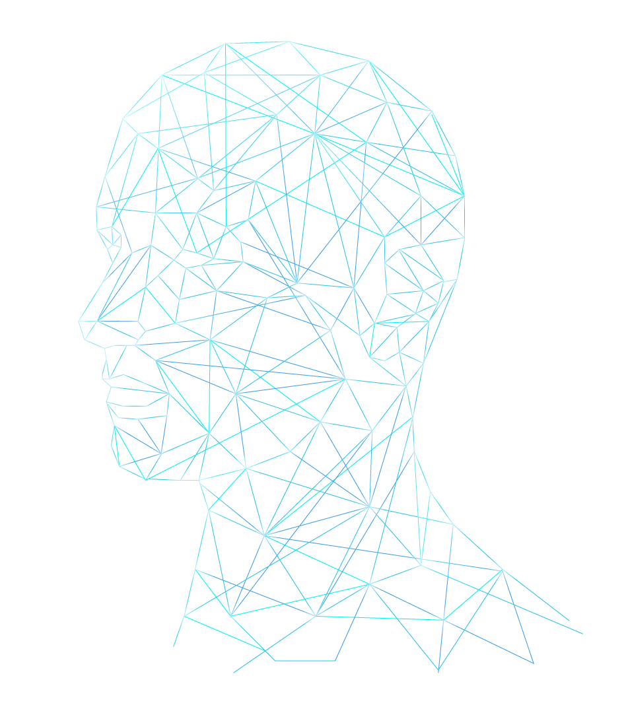
Introdcution
What is graph
Importance of graphs
Types of graphs

Slide 4
Background
Types of Layouts
Circular layout
Radial Layout
Tree Layout
Layered Layout

Slide 5

Background
How to choose suitable Layout ?
Minimizing the number of link crossings
Minimizing the total area of the drawing
Minimizing the number of bends (in orthogonal drawings)
Maximizing the smallest angle formed by consecutive incident links
Maximizing the display of symmetries

Slide 6
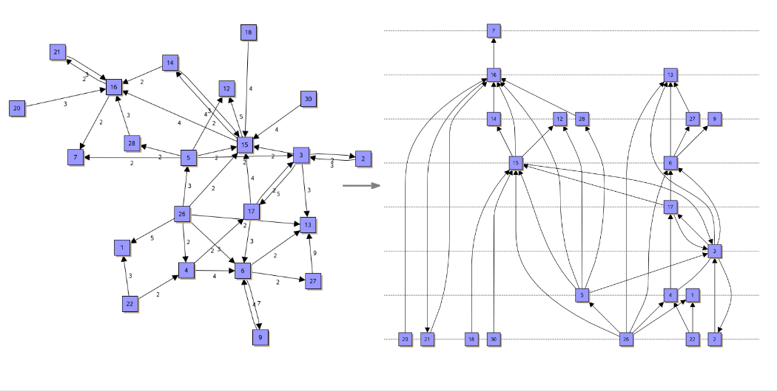
Hierarchic / Layered Layout

Slide 7
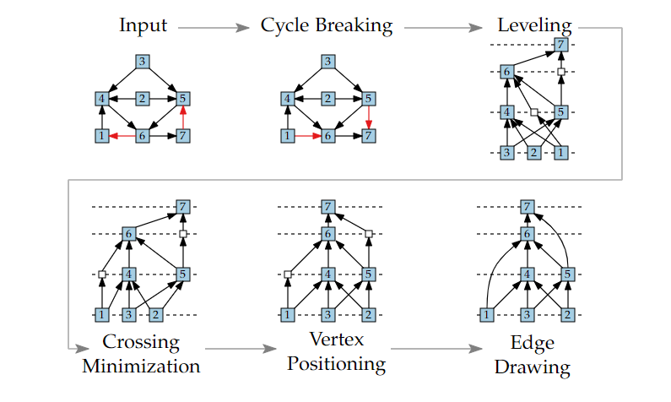
Implementation Methodology
Phases of Implementing Sugiyama Algorithm for layered Graph

Slide 8
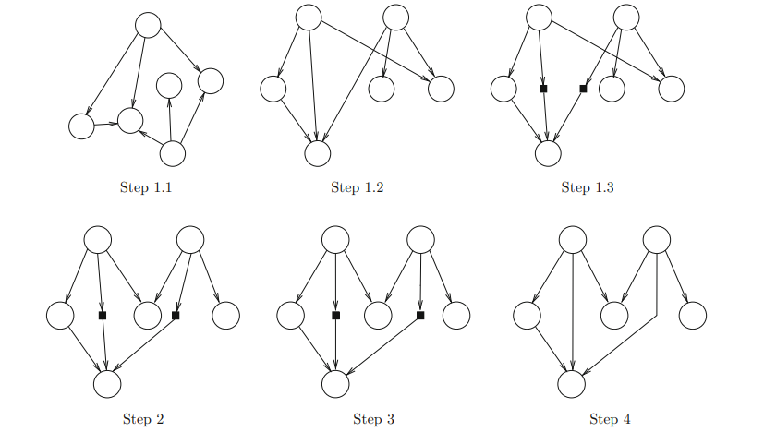
Implementation Methodology
Step1: Receiving a directed graph as an input to be processed into layered drawing.
Step 1.1: getting rid of edges causing cycles (reverse direction).
Step 1.2: Place vertices in horizontal layers.
Step 1.3: adding dummy vertices to support long span edges.
Step 2: Specify the sequence of vertices and minimize the total number of edges crossing.
Step 3: Determine the coordinates of vertices
Step 4: Draw the graph and removing dummy vertices.

Slide 9
Implemntation Methdology – Areas of application
Workflow visualization
Software engineering (e.g., state diagram or activity diagrams)
Process modeling
Database modeling (e.g., Entity-Relationship diagrams)
Bi-partite graphs (right hand side in a layer and left-hand side in second layer)
Planner graphs
Bioinformatics (e.g., biochemical pathways)
Network management
Decision diagrams

Slide 10
Basic Operation
Sequnac
01
03
Layering
Drawing
02
04
Related Apps : Y-files
Inatial set up of nodes and egdes coponent as well as layout mood
Determining order of nodes as well specifying constraints if any.
Layer assignment in which nodes are placed in Horizontal layers
Placing nodes in their new coordinates and redrawing edges

Slide 11
Advantages of Y-FILES
Works best with SE diagrams
Supports different layer modes
Allows customization
Works across platforms

Slide 12
Disadvantages of YFILES
Complex
Not open source
Does not work with dynamic graphs

Slide 13
Related Apps- Hierarchical clustering

Slide 14



Node pair sampling -Paris
Related Apps- Hierarchical clustering
Bottom-up approach
Treats every node like a cluster
Calculate distance between nodes ,
Collects nodes in one cluster and compare it with the nearest next node

Slide 15
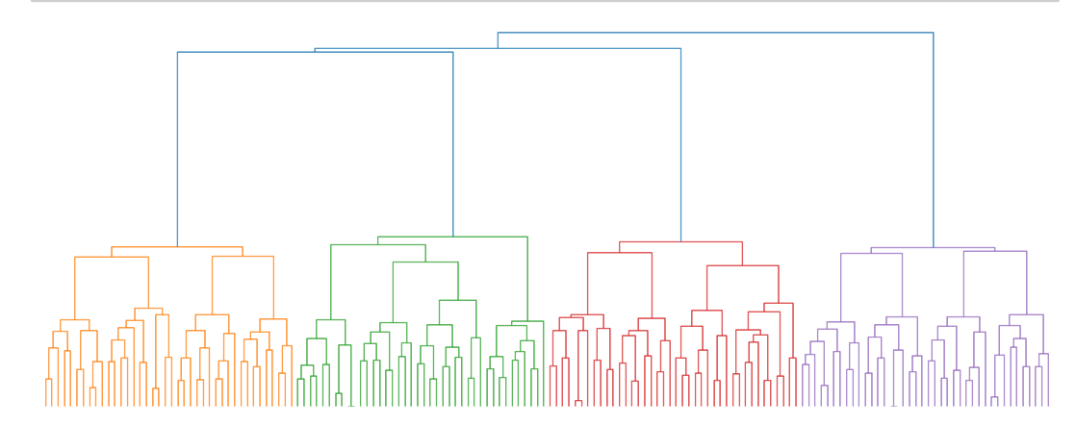
Node pair sampling -Paris
Related Apps- Hierarchical clustering

Slide 16
Advantages of Paris Algorithm
Efficient and most of all parameters free.
Fast implementation of dendrogram.
it run once and the output is shown on the dendrogram.
Captures multi-scale natures of a dataset

Slide 17
Disadvantages of Paris Algorithm
•Sensitivity to noise and outliers.
•Faces Difficulty when handling with different sizes of clusters.
•Might fail when computing large datasets.

Slide 18

Conclusion
What are graphs
Why graphs are important
What is Hierarchical layout
How does Hierarchical layout works
When to use Hierarchical layout
Y-files as a related app
Hierarchical clustering as a related app
General opinion

Slide 19
THANKS!
Do you have any questions?
Please keep this slide for attribution.

